Slide 2
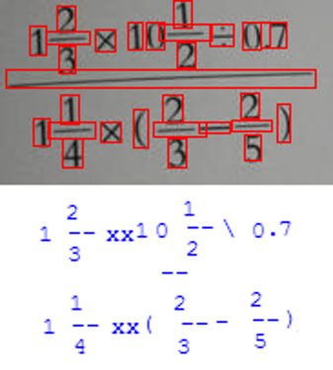
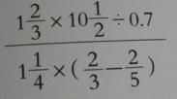
Convolution and Pooling
Up-sampling
NMS
Detection
Symbol Position
Regression
Recognition

